Slide 1
Sign Language Recognition System
Mena NADER nassem
Michael Adly Zakher

Slide 2
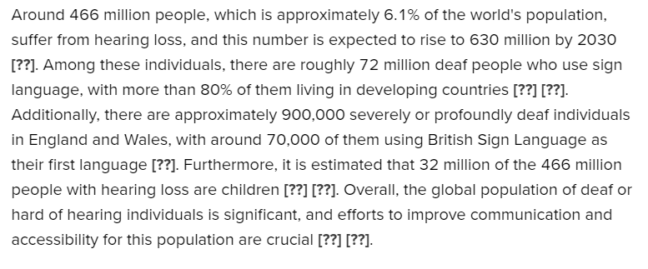

Slide 3
Objective
The goal of this project is to build a system capable of recognizing and classifying hand gestures used in sign language (American Sign Language in this case). By capturing hand landmarks and training a machine learning model, the system can predict the corresponding sign language character, helping to translate hand gestures into meaningful text.

Slide 4
Data Collection
Webcam Capture: The system uses a webcam to capture hand gesture images. For each class (representing different sign language gestures), the webcam collects a specified number of images and saves them in directories corresponding to the class labels (‘you’,’yes’).Storage: The captured data is stored in a structured format, creating folders for each class and saving images accordingly.

Slide 5
Data Preprocessing
Mediapipe Hand Detection: Mediapipe's Hand module is used to detect and extract the hand landmarks (e.g., keypoints on the hand like joints, fingers) from the images. The coordinates of these landmarks are then normalized and stored for further use.Data Preparation: The hand landmark coordinates are processed and normalized so they can be used as input features for training the machine learning model

Slide 6
Model Training:
Machine Learning Model: A Random Forest Classifier is trained using the processed hand landmark data. The dataset is split into training and testing sets, and the model learns to classify different hand gestures based on the landmarks.Training Process: The Random Forest model is trained on the dataset to recognize different classes (gestures). After training, the model's accuracy is evaluated using metrics like accuracy score, indicating how well the model can predict unseen data

Slide 7
Why we choose RandomForest?

Slide 8
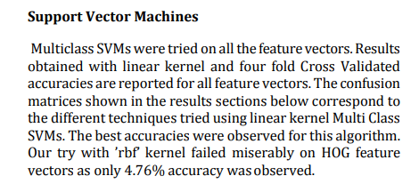

Slide 9
Model Prediction (Real-time Testing)
Webcam Input: The system captures real-time hand gestures through the webcam.Hand Landmark Extraction: Mediapipe processes the real-time input and extracts hand landmarks.Prediction: The trained model predicts the sign language gesture by analyzing the extracted hand landmarks. The predicted gesture is then displayed on the screen using OpenCV, along with a bounding box around the detected hand.Real-time Feedback: The system shows the predicted character (e.g., ‘you', ‘yes') overlaid on the webcam feed, providing immediate feedback to the user.

Slide 10
Tools & Libraries
OpenCV: Used for capturing images from the webcam and displaying results.
Mediapipe: A powerful library for detecting and tracking hand landmarks.
Scikit-learn: Used for implementing and training the machine learning model (Random Forest).
Pickle: For saving and loading trained models and datasets.
Outcome:
At the end of this project, you will have a system that can :
Capture and process hand gestures using a webcam.Recognize and classify American Sign Language (ASL) gestures in real-time.Provide visual feedback by displaying the predicted sign on the screen.
This project could be further extended by adding more sign language gestures, improving the model's accuracy, or even incorporating deep learning models for better performance.*

Slide 11
Mena Nader : Data collection, Data preprocessing
Michael Adly : Data modeling, Model Prediction

Slide 12
Any Questions?

